Slide 1
Mercury Notas

Slide 2
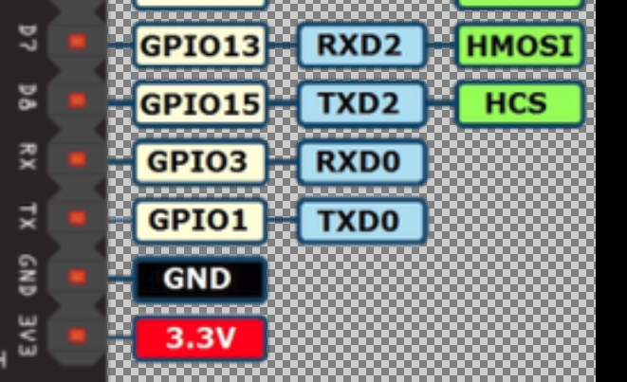
UART ESP8266
You can either use GPIO1/3 pins with UART0 (which are normal pins you use to upload the sketch), or call Serial.swap(); in your setup() function,
which changes the UART pins to use GPIO13 and GPIO15 as RX and TX.
AMICA Board:

Slide 3
UART ESP8266
Serial object works much the same way as on a regular Arduino. Apart from hardware FIFO (128 bytes for TX and RX) HardwareSerial has additional 256-byte TX and RX buffers. Both transmit and receive is interrupt-driven. Write and read functions only block the sketch execution when the respective FIFO/buffers are full/empty.
Serial uses UART0, which is mapped to pins GPIO1 (TX) and GPIO3 (RX). Serial may be remapped to GPIO15 (TX) and GPIO13 (RX) by calling Serial.swap() after Serial.begin. Calling swap again maps UART0 back to GPIO1 and GPIO3.
Serial1 uses UART1, TX pin is GPIO2. UART1 can not be used to receive data because normally it's RX pin is occupied for flash chip connection. To use Serial1, call Serial1.begin(baudrate).

Slide 4
UART ESP8266
By default the diagnostic output from WiFi libraries is disabled when you call Serial.begin. To enable debug output again, call Serial.setDebugOutput(true). To redirect debug output to Serial1 instead, call Serial1.setDebugOutput(true).
You also need to use Serial.setDebugOutput(true) to enable output from printf() function.
Both Serial and Serial1 objects support 5, 6, 7, 8 data bits, odd (O), even (E), and no (N) parity, and 1 or 2 stop bits. To set the desired mode, call Serial.begin(baudrate, SERIAL_8N1), Serial.begin(baudrate, SERIAL_6E2), etc.

Slide 5
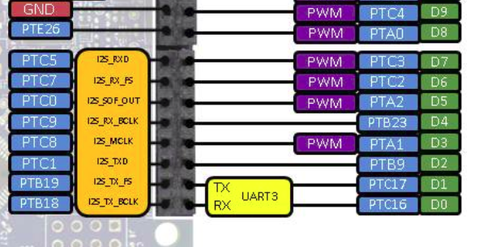
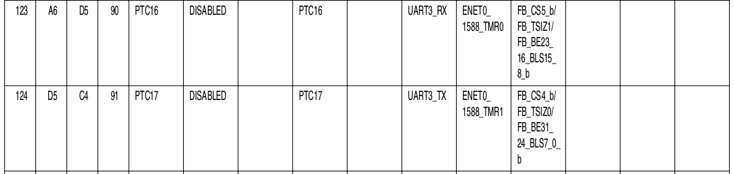
UART Kinetis K64F
Uart config : ALT3

Slide 6
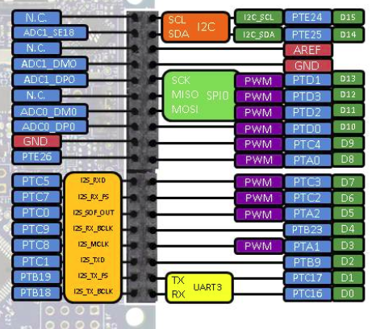
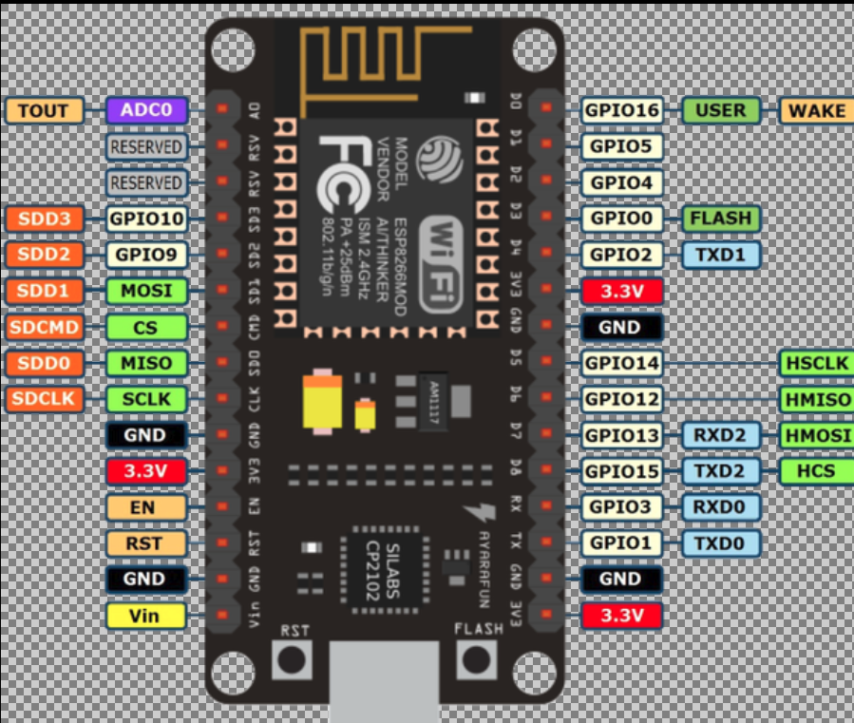
UART Kinetis K64F
TXD2 (GPIO15) → RX(PTC16) || RXD2 (GPIO13) → TX(PTC17)

Slide 7
UDP
Send
echo "This is my data" > /dev/udp/192.168.0.100/4210
Receive
nc -ul 5000

